Slide 1

An Automatic Fire Detection and Extinguishing System
Team Members :
210919114057 Karthick J
210919114062 Kumaravel R
210919114093 Siva Subramaniam R
Name of the Guide :
Ms. R. Kumutha, M. E., (Ph.D)
Assistant Professor

Slide 2
Abstract
With rising urbanization, the frequency of fire has been increased. There is a rapid need for quick and effective fire detection system.
Traditional fire detection systems are utilizing physical sensors to detect smoke and fire. It may result in false alerts.
By using image processing technology for detecting the fire, these limitations can be reduced.
Our project presents the automatic fire detection system designed with the Raspberry Pi as central processing unit and to connect the camera as hardware. The camera captures the video feed from the surrounding and feeds into the Raspberry Pi which gives signal to the relay.

Slide 3
Abstract
Relay acts as a switch to turn on the DC water pump which is used as the fire extinguishing system.
The entire code is written in python language using Open CV library for image processing.
The YOLO V5 model is used for image detection as it gives accurate results than other network models.
Thus the aim of the project is to make a reliable, quick, safe and smart system to reduce limitations like false alarms and to provide a cutting-edge solution for fire safety.

Slide 4
Introduction
Fire is very dangerous that brings great loss of life and properties. Yearly thousand of accidents related to fire happen all over the world due to power failure, accidental fire, natural lightning. So to control fire, various system is developed and being developed.
The existing systems are the smoke sensors types and sprinkler type systems that detect fire from smoke and designed to activate after reaching the threshold set temperature. Still, with this kind of system, there are many disadvantages like a false alarm, space coverage, signal transmission, and also the delay in a fire alarm.
Thus to swift the process, new technologies has to be utilised and an efficient system should be developed.

Slide 5
Objectives
To prevent and suppress unwanted fires by rendering prompt and efficient services and minimise the damage caused by it.
To provide stand by protection at large gatherings like important public and private functions and prevent the loss of life.
To minimise the risk involved in delay in fire detection and to provide assured safety against hazardous fire.
To reduce the limitations involved in the sensor based alarm system by using image processing technology.

Slide 6
Scope
Many existing fire detecting (fire extinguisher) systems are not modernized or automatic and also with high cost. Thus the scope of the project is to make a fire control system with low cost and to utilise the image processing technology to detect the fire as quick as possible. Such system will play an important role in maintaining and monitoring the safe of all kind environments and everything that damaged by fire.

Slide 7
Methodology
LITERATURE REVIEW
HARDWARE AND SOFTWARE REQUIREMENTS
SYSTEM DESIGN
SELECTION OF COMPONENTS, OPERATING SYSTEM, PROGRAMMING LANGUAGE AND ALGORITHM FOR DETECTION
COST ESTIMATION
IMPLEMENTATION AND TESTING

Slide 8
Literature review
KB Deve, GP Hancke and BJ Silva , (2016), “Design of a Smart Fire Detection System.”
The problem that was addressed by this work was to detect fires and reduce the occurrence of false positives in a kitchen environment.
Khan Muhammad, Jamil Ahmad, Zhihan ,Paolo Bellavist,“Systems Efficient Deep CNN-Based Fire Detection and Localization in Video Surveillance Applications.”
Their application in fire detection systems will substantially improve detection accuracy, which will eventually minimize fire disasters and reduce the ecological and social ramifications.

Slide 9
Literature review
Ala Rohika Reddy, M Vara Raghava Sai, Jollu Vamsi, C.S.K Raju, “An Automatic Fire Detection and Alert System”
This proposed system is an automated fire detection system, which on detecting fire, will take proactive measures of alerting the respective personnel, in addition to raising the alarm like a conventional fire detection system. It is implemented using the components like Node MCU, Fire sensor Buzzer and blynk app (for getting a notification and sending mail).
Leonid Tanklevskiy, Aleksandr Tarantsev , Ivan Balabanov , Elena Murashkevich , Denis Lobov , and Anton Mel’nik, “The Problem of Fire Control by Automatic Fire Extinguishing System”

Slide 10
Literature review
Modern fire protective equipment is divided by their constructive embodiment into sprinkler system, deluge system by the type of fire extinguishing agent into water, foam, gas, powder, aerosol, etc., and have different inertia and duration of fire extinguishing agent supply.
Tian Qiu, Yong Yan, Gang Lu “An Auto adaptive EdgeDetection Algorithm for Flame and Fire Image Processing”.
The algorithm detects the coarse and superfluous edges in a flame/fire image first and then identifies the edges of the flame/fire. The auto adaptive feature of the algorithm ensures that the primary symbolic flame/fire edges are identified for different scenarios. Experimental results proved the effectiveness and robustness of the algorithm.

Slide 11
Hardware Requirements
Camera - to capture and monitor the environment
Raspberry Pi - a microcontroller acts as a CPU
Relay - to act as a switch to activate/deactivate the pump
DC water pump - to pump out water to extinguish the fire
Power module - a voltage converter to give stable power
Monitor - to display the detected images
Mouse and Keyboard - to perform necessary actions

Slide 12
Software Requirements
Operating system - to start the Raspberry Pi and to provide
a convenient user interface.
Programming language - to instruct the computer in a way
it can understand.
Algorithm - for object detection using computer vision
technology

Slide 13
System Design
Raspberry Pi 3
Power supply
DC pump
Camera
Relay

Slide 14
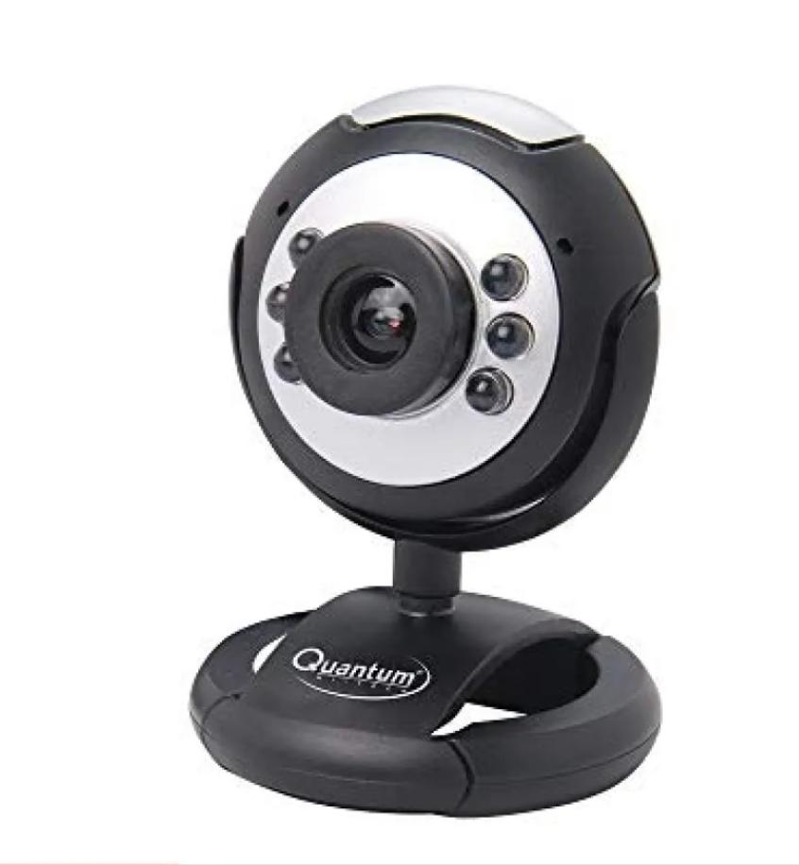
Selection of Components
CAMERA:
A small USB camera is used to make the system simple and cost efficient.
Quantum Hi-tech USB camera is chosen as it the best among other models available.
It is of a resolution of 30 MP, frame rate of 30 fps and with a night vision capability.

Slide 15
Selection of Components
RASPBERRY PI:
The Raspberry Pi 3 Model B is a popular single-board computer that offers several advantages over its predecessors and other similar devices.
Some of the reasons for choosing the Raspberry Pi 3 are improved performance, multiple USB ports, improved power management, Built-in Wi-Fi and Bluetooth, compatible with a wide range of operating system.
It also provides VideoCore IV GPU, HDMI output, Ethernet, 3.5mm audio jack, a CSI camera port, a DSI display port, and a micro SD card slot for storage.

Slide 16
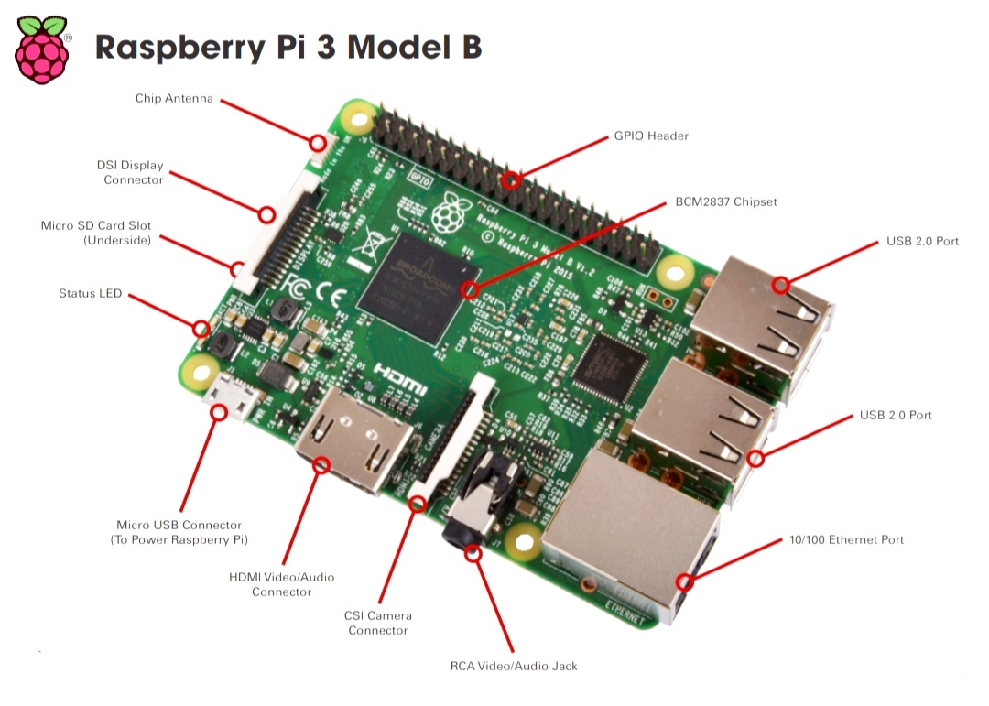
Selection of Components

Slide 17
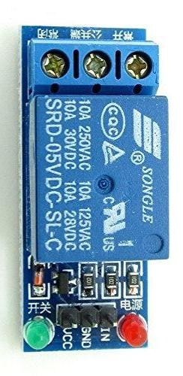
Selection of Components
RELAY:
Relays are commonly used to control high voltage or high current circuits with a low voltage or low current control signal from a microcontroller.
A 5V T73 type relay module (sugar cube relay) is chosen to control the operation of the DC pump.
It is a high quality Single Pole Double Throw (SPDT) relay. The voltage required to energize the coil is 5V DC.

Slide 18
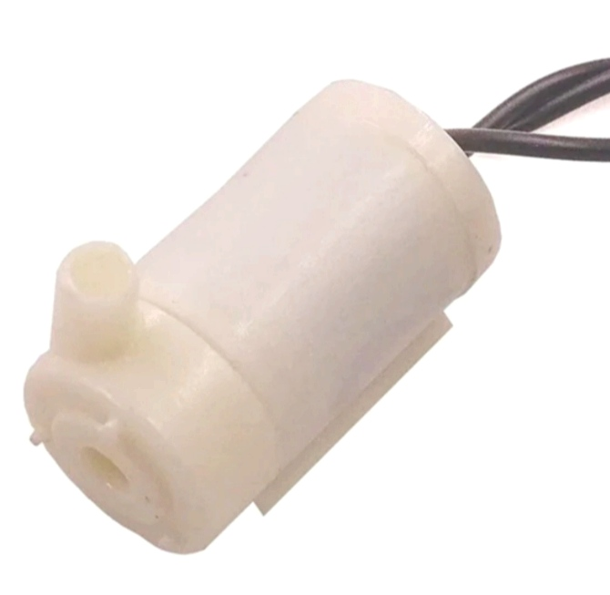
Selection of Components
The DC Mini Water Pump which can be operated from a 3-6V power supply is chosen as it is a low cost, small size pump motor.
Also suitable to be operated with a 5V relay.
It can take up to 120 litres per hour with a very low current consumption of 220mA.
By connecting tube pipe to the motor outlet, water can be pumped out to the fire outbreak zone.

Slide 19
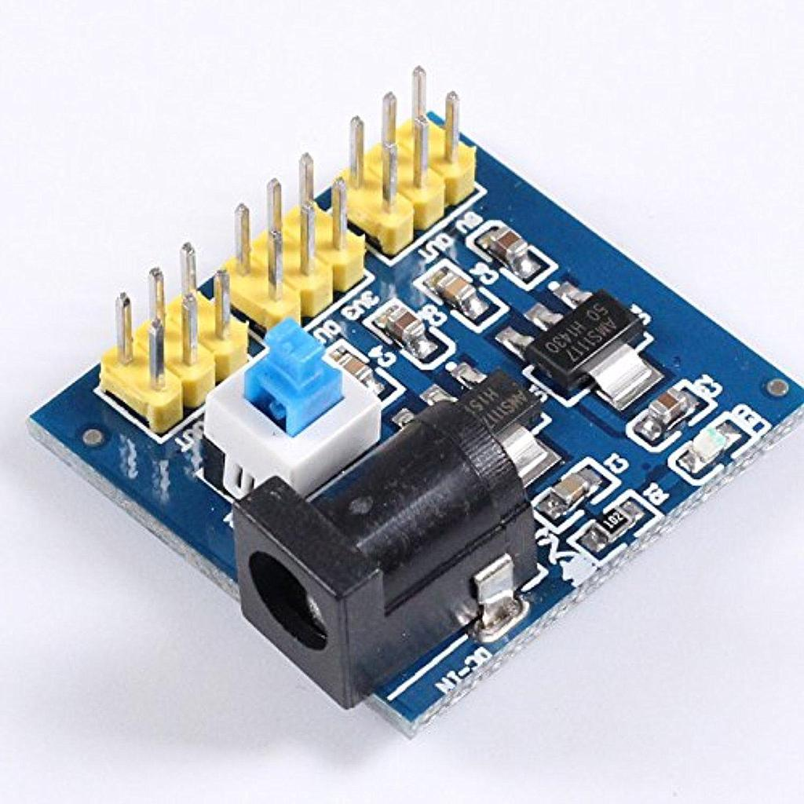
Selection of Components
To supply power to the relay and water pump, it is necessary to stabilize the voltage.
This can be achieved by the DC-DC 12V to 3.3V, 5V, 12V Power Module Multi Output Voltage Conversion is also known Step-Down Voltage Converter.
It is chosen because the device is very flexible and easy to use and also a small and handy module.
As 5V relay is used in this project, 5V DC power output is taken.

Slide 20
Selection of Operating system
Linux is chosen as it is the most popular and widely used operating system for Raspberry Pi.
Several reasons for considering it as the best OS are Open source, Lightweight, Compatibility, Flexibility, Security and large community support

Slide 21
Selection of Programming language
Python is chosen as it is a popular programming language for object detection.
There are several reasons why it is considered the best language for this task are easy to learn, versatility, extensive libraries for object detection, such as OpenCV, TensorFlow and PyTorch and pre-built algorithms and models.

Slide 22
Selection of Algorithm
Among various algorithm models, YOLO (You Only Look Once) is one of the object detection algorithm that aims to identify objects in an image and provide their bounding boxes with class labels.
The YOLOv5 is the latest version of the YOLO algorithm, and it is designed to be faster, more accurate, and more efficient.
Some reasons why YOLOv5 is considered to be better than other object detection algorithms include improved accuracy, faster inference speed and flexibility.

Slide 23
Cost Estimations
S.No | Component | Quantity | Cost (Rs.)
1 | Camera | 1 | 1200/-
2 | Raspberry Pi 3 | 1 | 5000/-
3 | Relay switch | 1 | 400/-
4 | DC Pump Motor | 1 | 900/-
5 | Wire & Flexible | 30pieces | 500/-
6 | Linux OS | 1 | 4000/-
7 | Monitor, Mouse, Keyboard | 1 | 5000/-
 |  | Total Cost Estimated | 17000/-

Slide 24
Implementation
ASSEMBLING THE COMPONENTS
TRAINING THE MODEL
IMAGE ACQUISITION
AND IMAGE PROCESSING
FIRE DETECTION
FIRE EXTINGUISHING PROCESS
PROTOTYPE TESTING

Slide 25
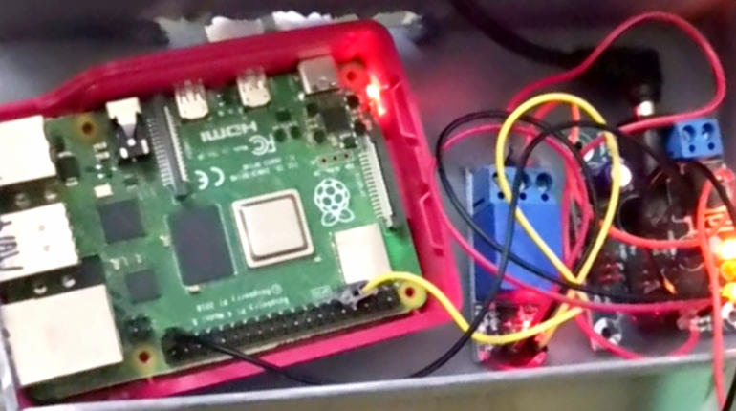
Implementation
ASSEMBLING THE COMPONENTS: The system can be made to work by integrating and assembling all the components involved. Such components are to be connected in a certain way.

Slide 26
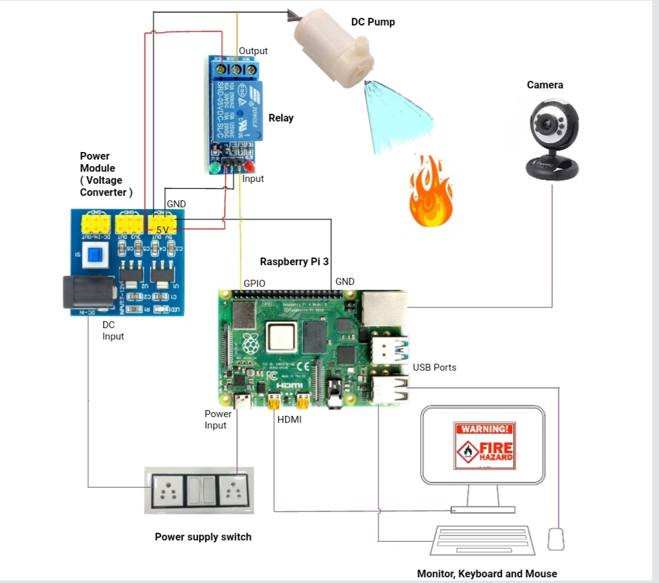
Implementation

Slide 27
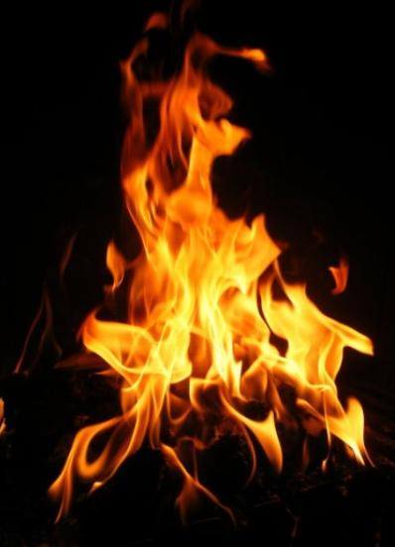
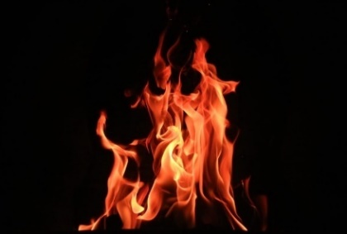
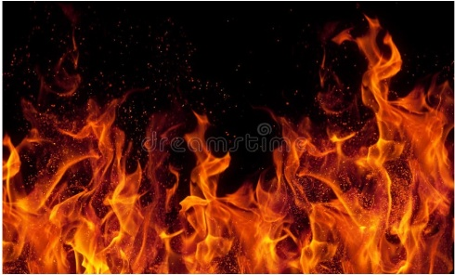
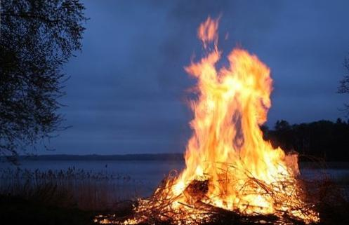
Implementation
TRAINING THE MODEL: YOLOv5 is the object detection algorithm used in this system which can be trained using custom datasets to detect objects in images or videos. This training process involves the several steps such as,
1. Data preparation - large and diverse dataset is to be created as it helps the model to learn to recognize fire. Several hundreds of images of fire are collected and labelled with bounding boxes around the objects of interest and saved in the yaml and COCO format so that YOLOv5 can read.

Slide 28
Implementation
2. Configuration: This includes specifying the location of the dataset, and other parameters like weights, image size, detection per image, confidence threshold values, etc.,
3. Training: Once configuration of model is done, model has to be trained using the annotated dataset. A deep learning framework, such as Torch is used to train the model on the labelled data and make YOLOv5 model to recognize fire.
4. Evaluation: To know how well it performs on new data, evaluating the model on a separate test set is to be done. Once the model’s performance is satisfactory, it can be deployed in a environment where it can be useful in detecting fire in real-time images or videos.

Slide 29
Implementation
IMAGE ACQUISITION AND PROCESSING: To capture and process the image, Open CV library is used which is an open-source computer vision library providing wide range of functionalities like capturing video from camera, reading an image from a file, saving and displaying the images.
FIRE DETECTION: The pre-processed image is passed through the YOLOv5 model to get the predictions. The function called `model.forward()` is used to get the output of the model for the input image. Once the fire is detected and recognized, the image need to be post-processed to refine their locations, sizes, and shapes. This can involve techniques such as non-maximum suppression (NMS) and bounding box regression.

Slide 30
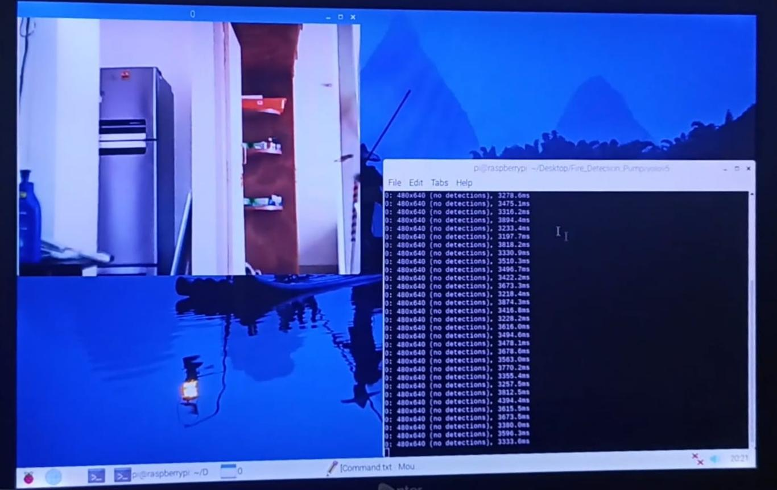
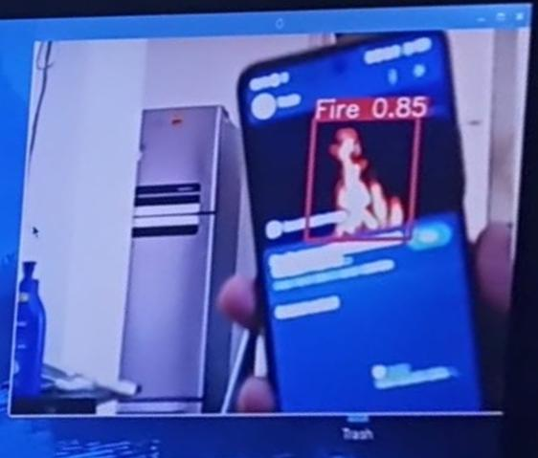
Implementation
FIRE EXTIGUISHING PROCESS: Once the fire is detected, Raspberry Pi has to give signal to the relay. It will turn on the DC water pump and extinguish the fire in a rapid manner.
PROTOTYPE TESTING: the prototype is to be tested as a whole system to know how well it is working
No Fire Detected Fire Detected

Slide 31
CONCLUSION
Fire detection and extinguishing systems play a crucial role in ensuring the safety of buildings and their occupants. As technology is getting better day by day, to keep it up with the technology and to optimize the current system, the new system has been created by using image processing technology.
YOLOv5 machine learning technique makes the system fast, easy to train and also achieve almost 100 percent accuracy.
Thus the prototype successfully detects fire on real-time by continuous monitoring and achieved the required accuracy on the various tests performed.
Thus this system can be a game changer in the field of fire safety and hazard management.

Slide 32
FUTURE SCOPE
The future scope of the fire detection and extinguishing systems by image processing technology is quite promising, with the advancement of technology. Some potential areas of development includes,
Integration with Building Management Systems: To provide real-time data on fire safety and enable more efficient emergency response.
Smart Alert System: Giving personalized alert message to the mobile phones of authorities who are responsible for the fire safety management.
Speeding up fire detection and extinguishing process: By using Raspberry Pi 4 instead of Raspberry Pi 3 B, the system can run faster since the clock speed of processor is improved as 1.5 GHz and can detect the fire even more faster.

Slide 33
FUTURE SCOPE
Targeted Fire Suppression: Can be achieved by using servomotor by which the linear and angular position can be altered to target the fire zone and splash water in a required force based on the extent of fire outbreak.
Artificial Intelligence (AI)-Enabled Fire Detection: AI-based fire detection systems which can learn from past data and patterns to identify potential fire risks and take preventive measures to reduce the chances of a fire.
Overall, the future of fire detection and extinguishing systems looks promising with the incorporation of new technologies and increased focus on safety measures.

Slide 34
THANK YOU

